Slide 1
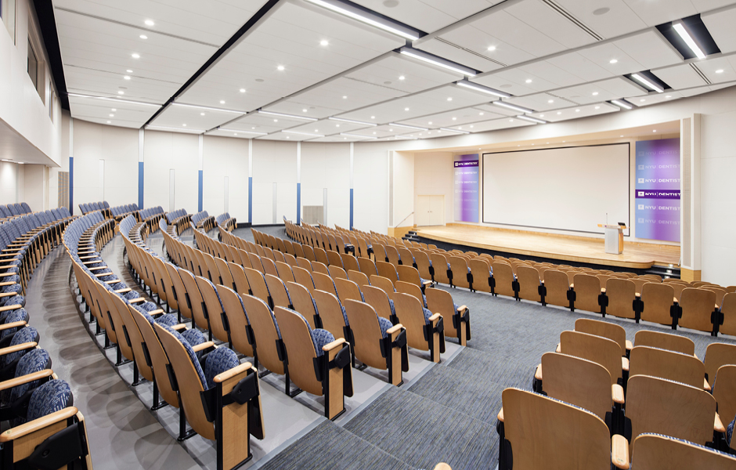
LiveClass
Sophie Serrano Beyza Bozbey Jonathan Yao Zijian Hu Hans Chang

Slide 2
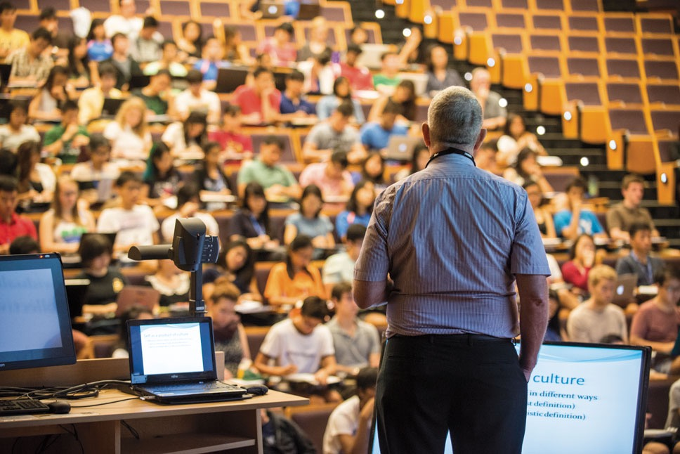
What is LiveClass?
LiveClass is an interactive website created to better connect students, teachers, and any individual interested in learning through easily accessible livestream and chat features.

Slide 3
Continuing Professional Development
Encryption
JavaMail API
WebRTC
Node.js
Live Video/Audio Stream
Materialize
ECMAScript 6

Slide 4







Skills and Tools
Google Drive
IntelliJ IDEA
Slack
Github
JSTL
VirtualBox
Lucid Chart

Slide 5


Design and Development Decisions : Teamwork
Difficulty scheduling group meetings due to conflicting schedules
Back End Team
Front End Team
Sophie Serrano
Jonathan Yao
Beyza Bozbey
Zijian Hu
Hans Chang
Notes:
Good:
Teamwork: good team structure, front end team, backend team.
Design: add this part
Didn’t work:
Teamwork: some communication problem initially, have trouble all meeting together because of schedule conflict
Design: some of the most important parts were implemented late, and we need to change a lot of other smaller things. Github issues that took some time to solve

Slide 6
Design and Development Decisions : Project Design
Order of implementation
Github issues
DAO Design
Reducing user types
Method of enrolling in classes via access code
Notes:
Good:
Teamwork: good team structure, front end team, backend team.
Design: add this part
Didn’t work:
Teamwork: some communication problem initially, have trouble all meeting together because of schedule conflict
Design: some of the most important parts were implemented late, and we need to change a lot of other smaller things. Github issues that took some time to solve

Slide 7
Outside Classes
CSCI 103L - Introduction to Programming
CSCI 104L - Data Structure and Object Oriented Design
ITP 104 - Web Publishing
ITP 302 - Advanced Web Publishing
CSCI 485 - File and Database Management
Notes:
CSCI 485 is equivalent of CS 306 - Database Systems (from another university) - Beyza

Slide 8
Data Structures
ArrayList
SynchronizedMap
Vector
SynchronizedSet
Blob
Notes:
I’ll add more information later - Hans

Slide 9
Multi-Threading
Livestreaming
Divide connections into groups
Each group of connections run concurrently and send messages independently

Slide 10
Networking
Livestreaming
Created sockets to have consistent connection between server and clients
Used sockets to send video
and audio

Slide 11
User Login Functionality
Guest
Authenticated
Student
Course Staff
Can only view public lecture streams
Cannot use the chat functionality
Can create an account
Can view both public and private streams
Access to the chat feature in streaming page
Can login in order to access the streams for their courses
Can join classes through an emailed access code
Can view both public and private streams
Access to the chat feature in streaming page
Can login in order to access the streams for their courses
Can provide students with access to courses through an emailed access code
Notes:
Maybe add images on the next slide?

Slide 12
DEMONSTRATION

